Slide 1
Forecasting London House Prices
Using Time Series Modelling to Forecast which London Postcodes to invest in
Andrew Rowan, Flatiron School

Slide 2

Business Problem
Buying a house is usually the purchase any of us will make and so often we are limited to viewing a house just twice before purchasing!
In a city like London that is so vast and difficult to have intimate knowledge of every area, a tool to inform you if a Postcode is a safe investment would be invaluable.

Slide 3
Methodology
Baseline Model
Optimised Model
Auto ARIMA for Multiple Postcodes

Slide 4
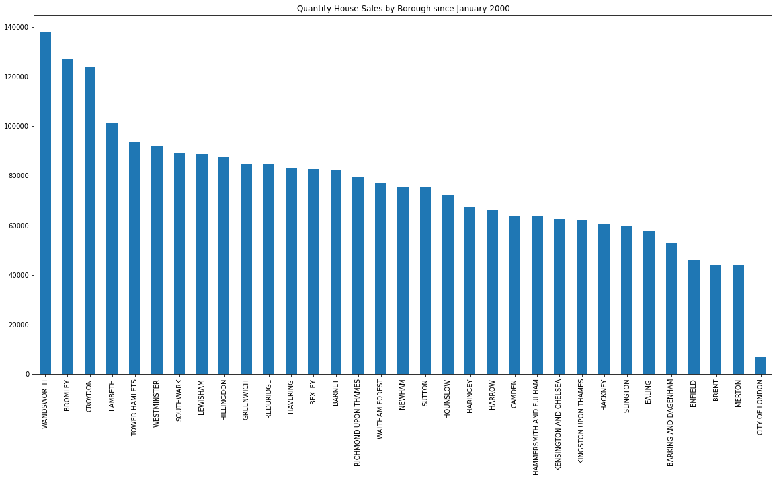
Data – 2.5 million rows

Slide 5
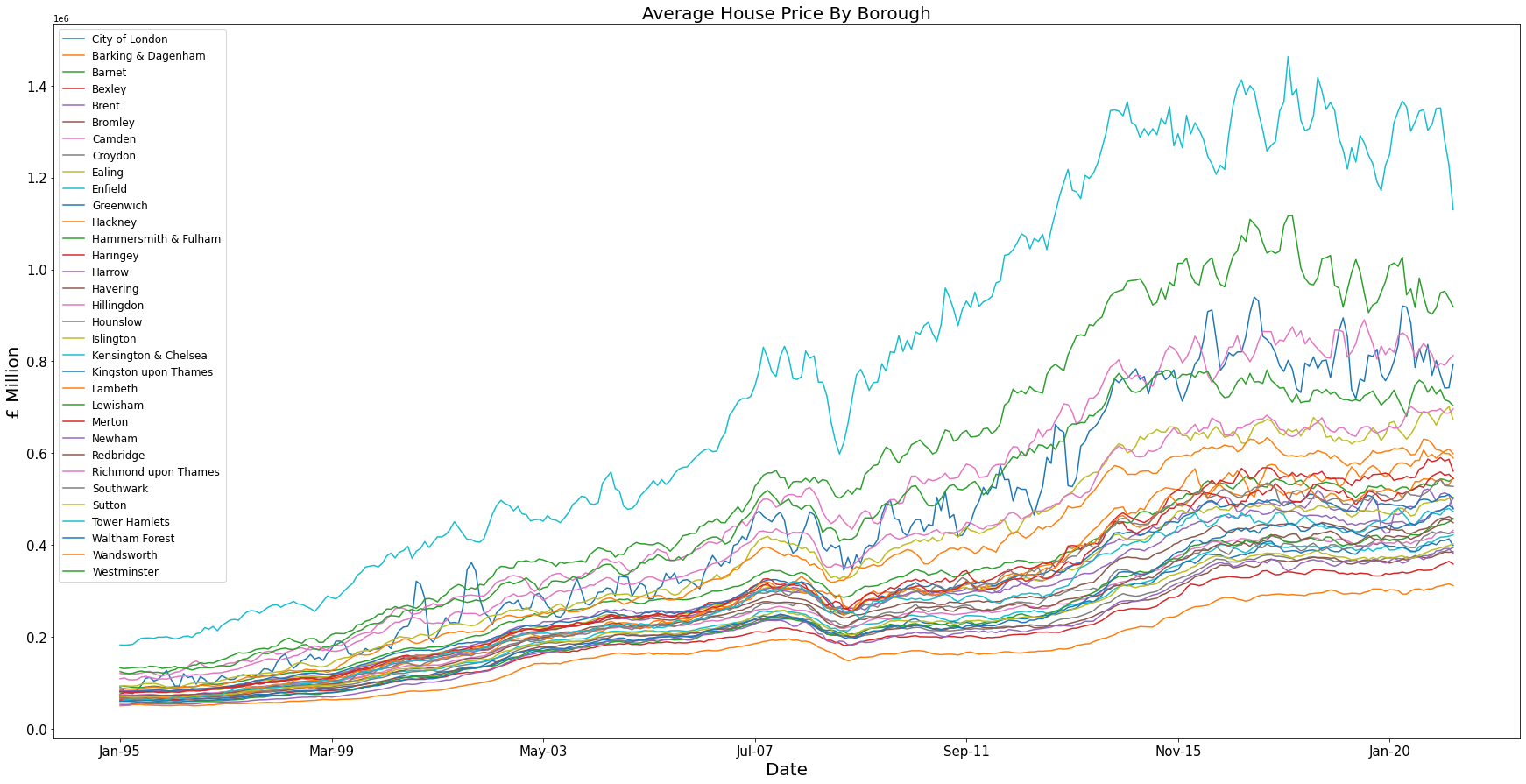
Data Understanding

Slide 6
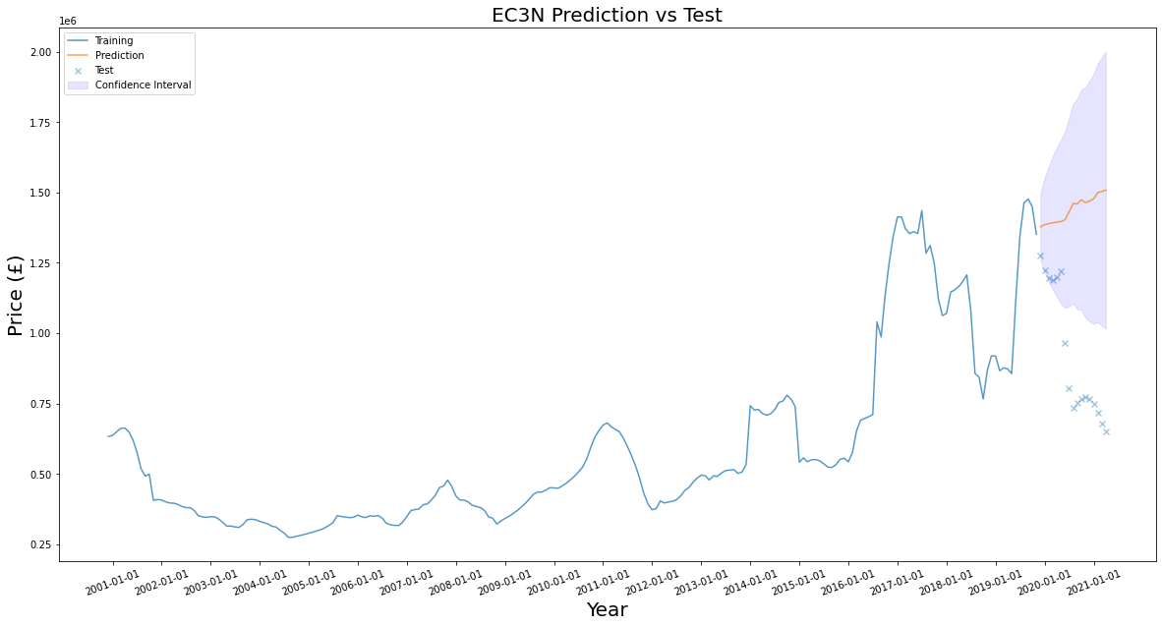
Models & Results
Some models had higher errors than others, this was due to the sparsity of the data making it more susceptible to outliers, or the extreme fluctuation in price due to COVID-19

Slide 7
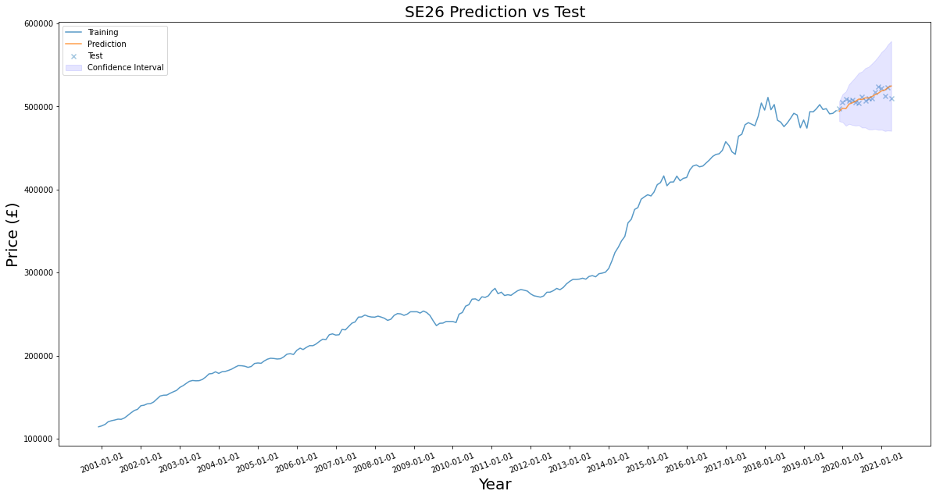
Models & Results
Some models had very small errors, SE26 for example just 0.94% symmetrical mean absolute percentage error and a very good match to the actual data

Slide 8
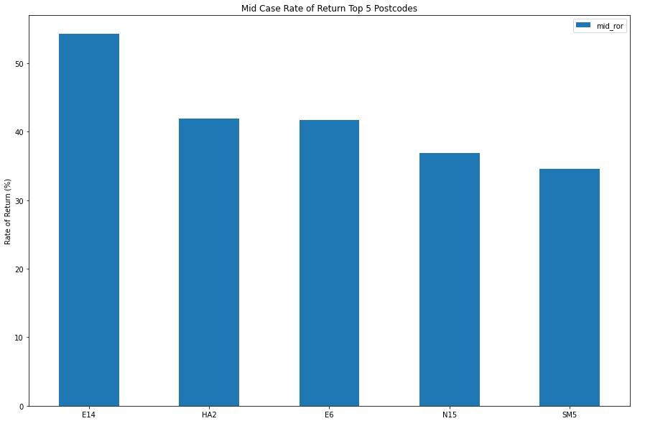
Top 5 Postcodes
Top 5 postcodes expect a rate of return between 35% and 55% over 5 year period

Slide 9
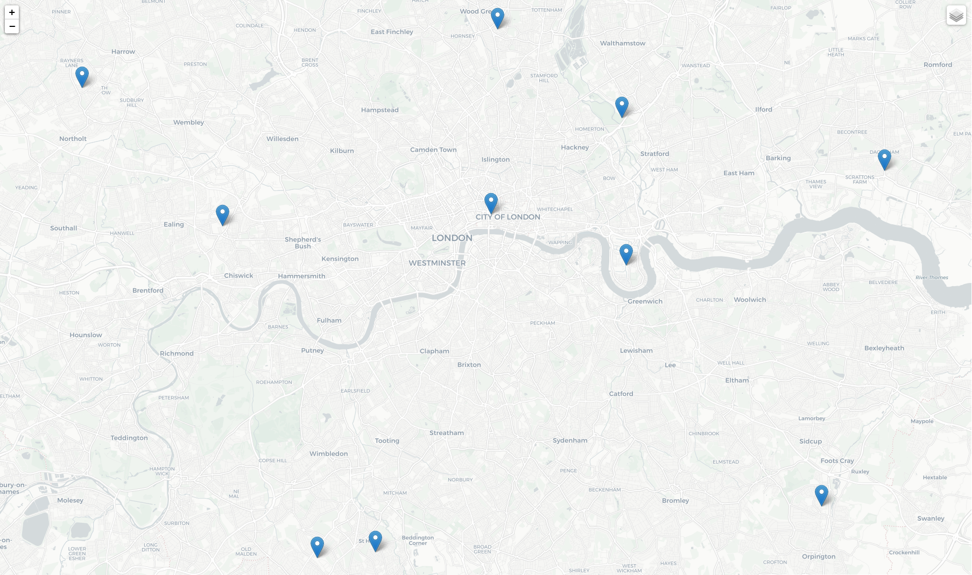
Top 10 Locations

Slide 10
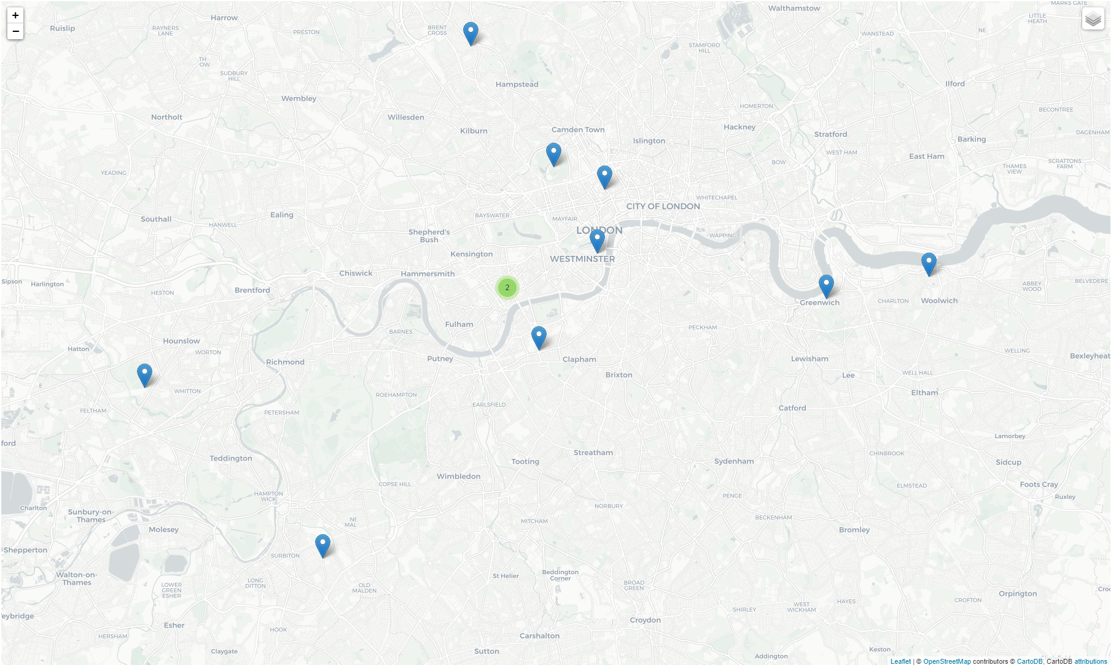
Bottom 10 Locations

Slide 11
Conclusions & Recommendations
Central and Expensive Boroughs seem to be subject to biggest fluctuations in price
4 of the top 5 postcodes with the highest rate of returns are outside what would be considered Central London
- 4 of the bottom 5 postcodes for rate of return are in central areas and/or close to financial hubs (The City of London or Canary Wharf)
The average price of a home in the top 5 postcodes ranges from £413k to £623k

Slide 12
Further Work
As time series modelling is so sensitive to recent data, it is imperative that these models be updated regularly (at least quarterly) with recent data to ensure modelling errors remain small.
It may be useful to introduce some exogenous data into the models:
- Bank of England interest rates
- COVID-19 infection rates
- Lockdown events
- Number of people returning to office work

Slide 13
Thank You!
Email: adrowan88@gmail.com

